Slide 1

Conference Presentation
Topic (or) device name : ”HOME AUTOMATION AND SAFETY SYSTEM”

Slide 2
Introduction
This project have a nick name which is EVERYTHING , EVERYWHERE ALL AT ONE . it is means that all the major problems are controlled in only one embedded system , That major problems are occurs in the home system.
This problems are cause more affect on the safety system.
Our project is mainly controlling problem with correct accurate time system management and reduce the electricity consumption .,

Slide 3

Problem Statement
If this project is implement in a home means , then the home act as a” smart home (or) problem Controlled home”.
A single programmed Arduino is used to solve the multi tasks. the multi tasks are,
Automatic control of lights and fans.
Give a protection for cylinder leakage.
Keep the temperature with certain range.
Always keep the water level in the water tank like Syntex tank
The sensing tasks are care out by using “accurate sensor which have less time delay” for passing signal and also the execution of program for the sensing process is very less time with very efficient for all the problems, because the time delay is managed in this project.

Slide 4
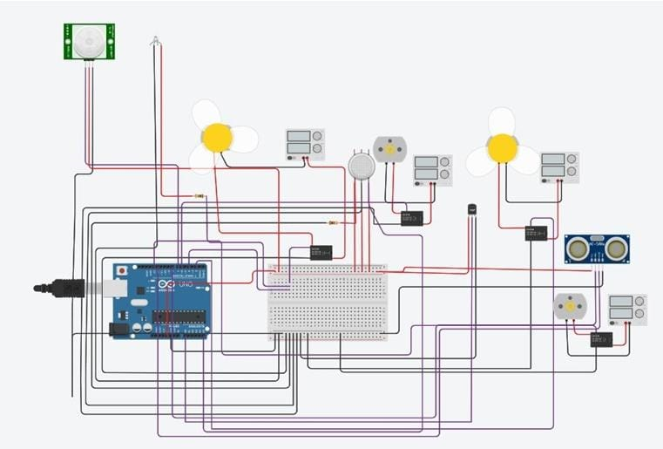
CIRCUIT DESIGN

Slide 5
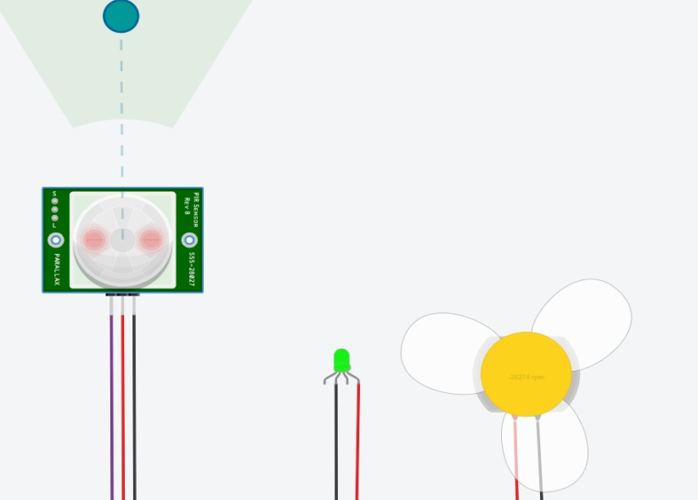
Problems
Proposed solution / Big Idea about project ,
1st solution of 1st problem : BRIGHTER THE SENSOR BRIGHTER THE HOME →
The main sensor implemented here is the PASSIVE INFRA RED SENSOR (PIR).
Here ,the sensor detects if any person enters its range of infrared rays.
If it detects, then the programmed ardunio is turn the light and fans , when all the person leaving means all are turned off.

Slide 6
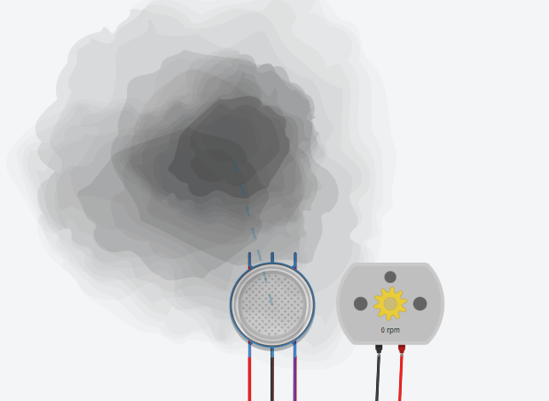
2nd solution for 2nd problem :Gas leakage Don’t worry→
Here , the MQ2 GAS SENSOR is used as a protective sensor.
If any gas leakage is occurs through the cylinder, it detects and send a signal to a motor which is rotate only one revolution.
the one revolution of rotation motion is used to open the window through the “L” shaped mechanical strip.
At the same time , all the electrical compound are switch off by off the main supply because any short circuit is occurs means the house will fire .

Slide 7
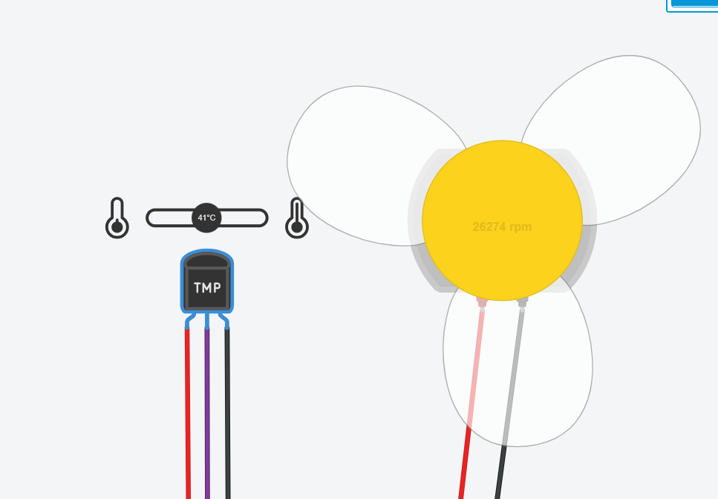
3rd solution for 3rd problem: “FEELING HOT, JUST CHILL DOWN “
Here, temperature sensor LM35 is act as a controller sensor.
If the kitchen temperature is above 40-45 degree, then it turns on the exhaust fan to make the room temperature to 35 to 38 degree Celsius. This process is keep on continuous for protecting the kitchen from “oil viscosity”.

Slide 8
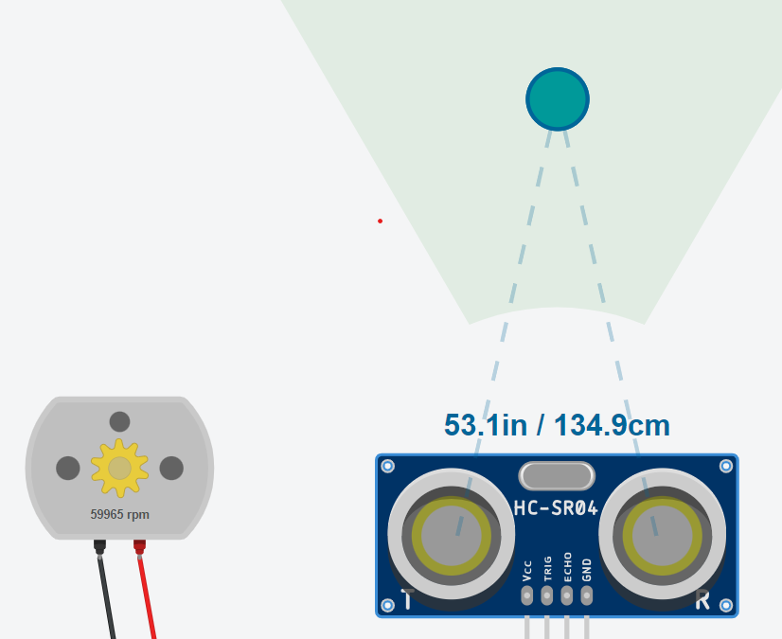
4th solution for 4th problem:” SAVE AQUA FOR EXISTENCE”
The ultrasonic sensor is used as a level maintained sensor.
If the water drops down below or above the given area, the ultrasonic sensor detects the range then it makes the tank full by no and off the motor (water pumps).
thus this plan saving both water and current.

Slide 9
SPECIALISED THINGS OF THE DEVICE
Time management
One embedded board for large system
This devices have accurate time management system , because it have a technical trick in the program .
if this all the process is control in different controller is more costly and also the implementation is more complex.
all are controlled in one board , the cost is reduced and implementation is easy but the program have complex trick .

Slide 10
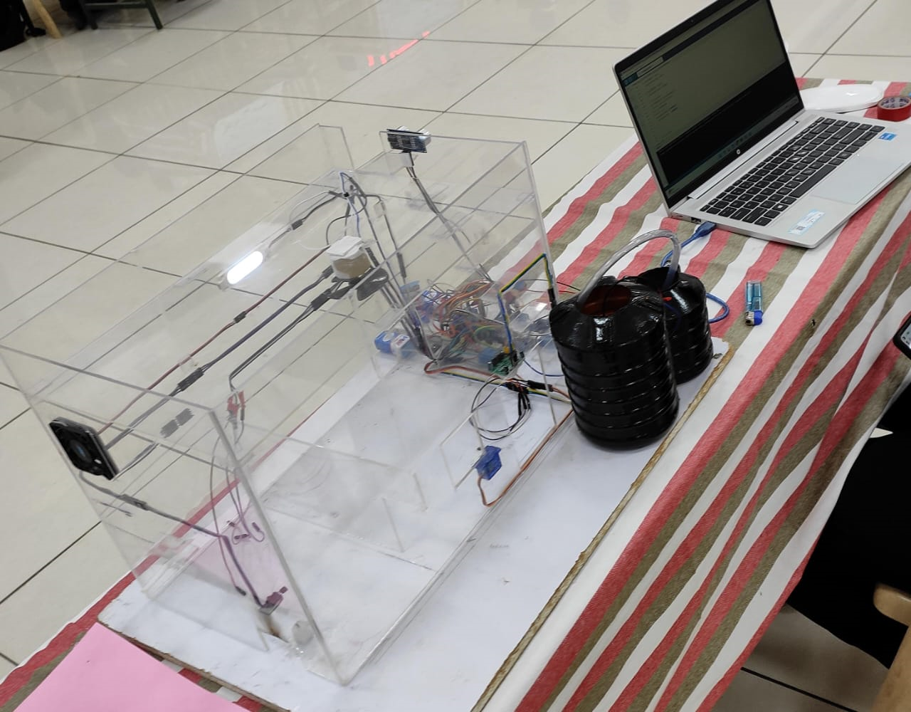
PORTABLE MODEL OF THE DEVICE

Slide 11
FINAL STATEMENT (or) IMPLEMENTATION
IF THIS DEVICE IMPLEMENTED MEANS THE HOME HAVE
AUTOMATION SYSTEM
Kitchen cleaning system
Aqua monitoring system
Electricity reducatiion system
Safety system

Slide 12
TOTAL GOOD THINGS…

Slide 13

ANY QUERIES…;

Slide 14
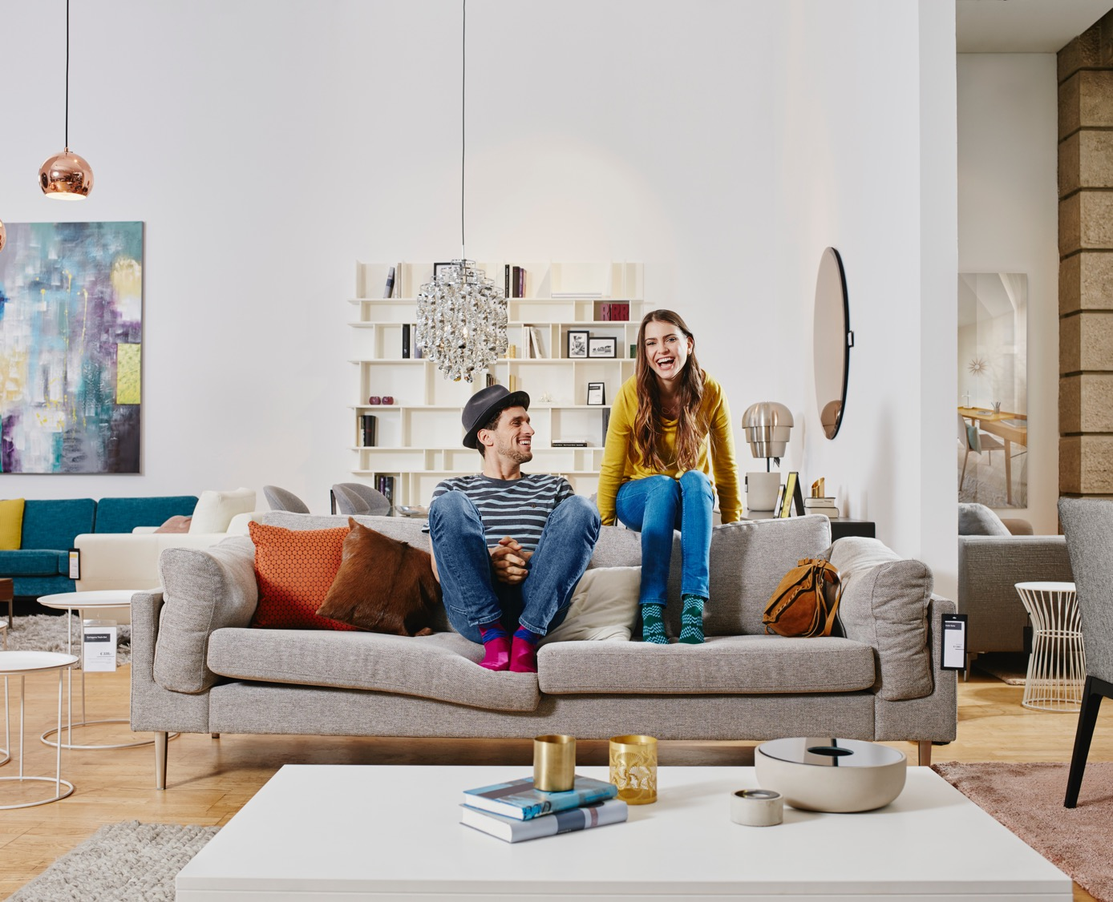
Thank You

